Slide 1
GOLD FinApp Appeal
Escadar Alemayehu & Francesca Burke

Slide 2
ELP Participant Retention
Lessons of the 2016 ELP structure
Family structure
Off-campus bonding
Retreat
Women’s Leadership
Focus on the challenges of 2020

Slide 3
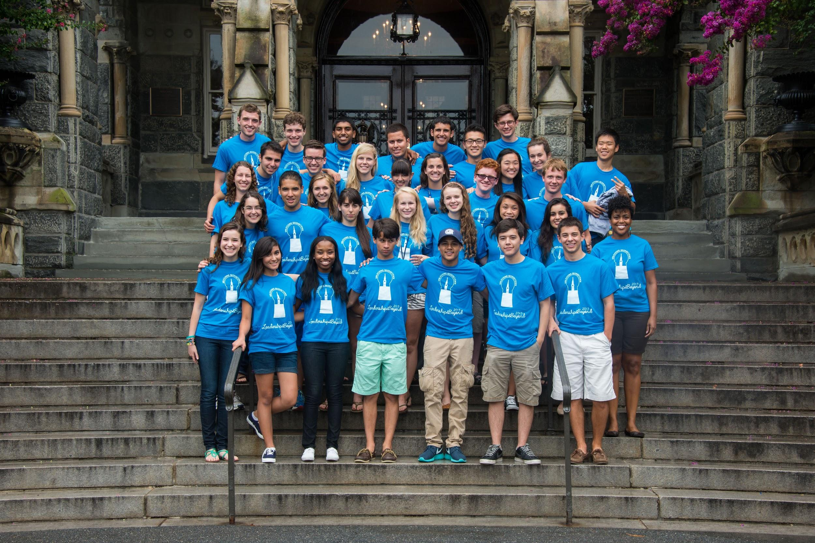
The GOLD Program
L&B Growth
34 participants in 2018 → 40 in 2019
Expansion of Alumni Network
Creation of newsletter
Active database of 400 alumni
Establishing Mission
GOLD fosters a community in which new
and current Hoyas explore leadership and gain skills used to affect positive social change in their communities.

Slide 4

GOLD & The CSE
Transitioning coordinators and advisor
Depend on the CSE budget for coordinator funding
Plan to closely monitor hours logged
Potential inability to fairly compensate

Slide 5
Questions?
Thank you for your attention!

